Slide 1
Education
Domestic Violence in USA

Slide 2
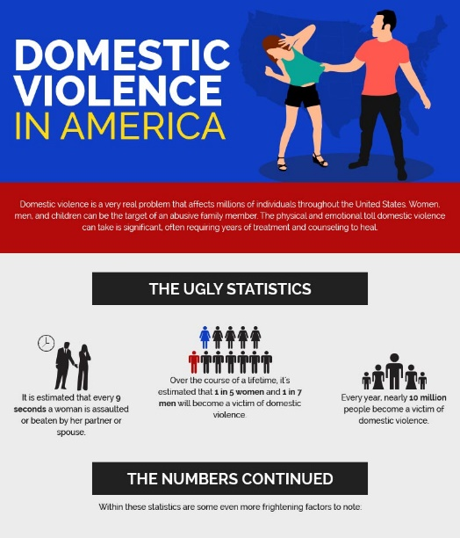
Introduction
Domestic Violence is aggressive behavior within the home and involves abusing the partner
Globally, women are the major victims of domestic violence
Women tend to experience different forms of domestic violence
Forms of domestic violence include sexual violence, economic control, physical violence, emotional violence and psychological assault.
In the USA, domestic violence has been common affecting the daily activities of people (Lloyd, 2020).
It is a major public health problem affecting millions of people
The media has been reporting domestic abuse victimization of celebrities showing that even respected people can be involved in domestic violence.

Slide 3
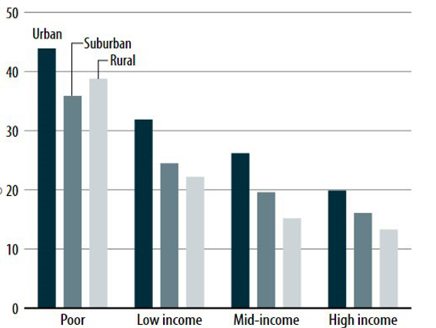
Cont…
Domestic violence is affecting 3%-5% of the current relationships in the USA based on gender, race, or economic status (National Coalition Against Domestic Violence, 2019).
More than 2 million women are affected
About 800, 000 men are also affected by domestic abuse.
One-third of the women are expected to be victims of intimate violence in their lifetimes.
About 25% of LGBT have undergone intimate partner abuse.

Slide 4
Factors Contributing to Domestic Violence in the USA
There is no specific cause of domestic violence
Women at a high risk of domestic violence are those whose male intimates abuse drugs and are unemployed
Some also undergo violence because of poverty and lack of education from intimate partners
People not married and are in heterosexual relationships are at more risks of undergoing domestic violence
Believe that men are superior to women is also a risk factor for becoming abusive in a relationship

Slide 5
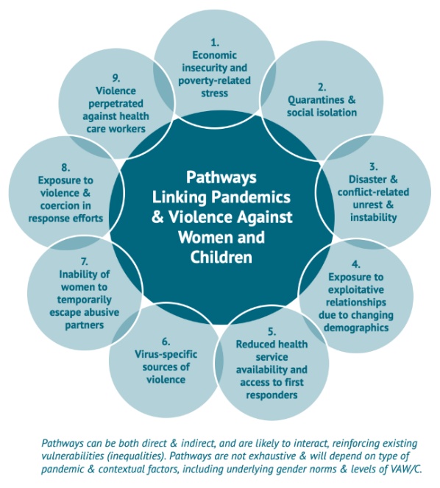
Cont…
According to Frederick (2017), people who grow up in families where domestic violence was rampant can also perpetuate the problem in future
Teenagers suffering from mental illness are at high risk of undergoing mental illness
African-American and Hispanic teens also are at risk of undergoing domestic violence due to socio-economic status.

Slide 6
Impacts of Domestic Violence
Domestic abuse is linked to health problems
Between 25%-50% of families are homeless because of intimate partner violence
Domestic violence is connected to health care cost and reduced work productivity yearly
Victims of domestic violence find challenges in raising children, suffering from family disruption
The problem is linked to psychological abuse and increases mental health problems in the USA.

Slide 7
Cont…
People undergoing intimate partner violence are at risk of developing anxiety and depression
Partner abuse of expecting women has been linked to preterm deliveries
Children whose families are undergoing domestic violence are at risk of developing lower intellectual functioning.
Children are at high risk of undergoing emotional problems and involving in drug abuse
Domestic violence results in homicide

Slide 8
Strategies for Coping with Domestic Violence
Laws against domestic violence in the USA have been formed protecting both children and women.
Violence Against Women Act (VAWA) was passed in 1994 and renewed in 2013 as legislation against domestic violence
Educational programs have been provided by healthcare providers to reduce domestic violence

Slide 9
Non-profit Resources Dealing With Domestic Violence in the USA
To address the issue, there are non-profit resources created to respond to domestic violence
The Domestic Violence Resource Network (DVRN) is funded by the Department of Health in the USA informing and strengthening interventions and preventions of domestic violence.
National Health Resource Centre on Domestic Violence based in San Francesco
National Indigenous Women’s Resource Centre located in Lame Deer

Slide 10
References
Frederick, C. M. (2017). Hurt People, Hurt People: Domestic Violence as an Expression of the Soul. Pacifica Graduate Institute.
Lloyd, M. (2020). Gendered Domestic Violence and Abuse, Popular Culture and the Digital Revolution. In Gendered Domestic Violence and Abuse in Popular Culture. Emerald Publishing Limited.
National Coalition Against Domestic Violence (NCADV). (2019). National Statistics Domestic Violence Fact Sheet. Retrieved from: https://ncadv.org/STATISTICS

